Slide 1


DISEASE PREDICTION
end to end ML based
GUIDED BY :PROF. M.A. Mahant
Shraddha Annadate(31)
Kavish Dhirawat(32)
Sejal Madhekar(33)
Dnyaneshwari Narale(34)
Notes:
1

Slide 2
IDEA OF PROJECT IN DETAIL
To extend the role of Technology in the Medical field .
Most of the cases arise leading to death due to lack of timely medical check up so to cope up with all these problems we decided to do this project .
To make a website which will be easy to use and implement for Health care in day to day life.

Slide 3
OBJECTIVES:
The main objective is to predict the diseases from the given symptoms.
In order to predict disease several Parameters has been consider such as body mass index, cholesterol level, blood sugar, blood pressure and so on.

Slide 4
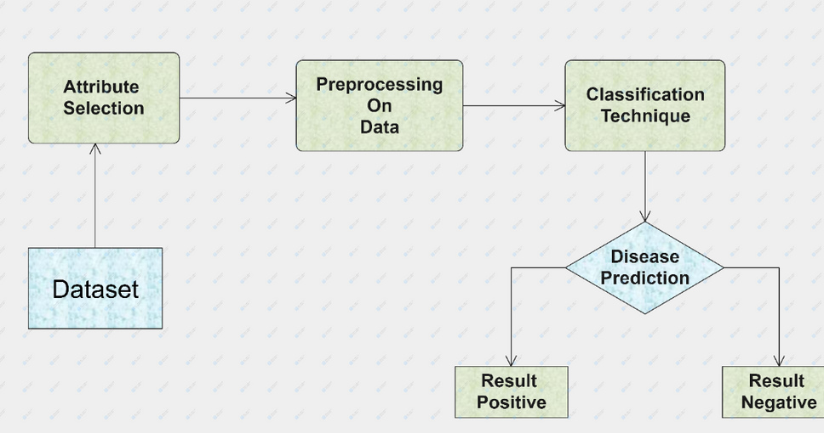
SYSTEM ARCHITECHTURE

Slide 5
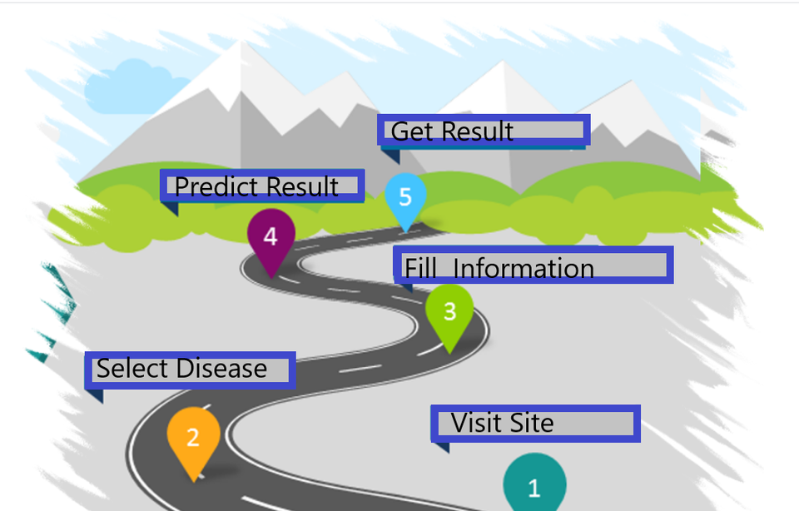
User ARCHITECHTURE

Slide 6
Description and Working:
It is a web based application that predicts the disease of the user with respect to the symptoms given by the user. The system will initially be fed data from different datasets , the data will then be pre-processed before further process is carried out, this is done so as to get clean data from the raw initial data, as the raw data would be noisy, or flawed.
This data will be processed using Data mining algorithms, the system, will be trained so as to predict the disease based on the input data given by the user. The PredictWithCare application is implemented into two parts, System part and the user part. The duty of the System is training the system for creation of the disease prediction model. The user uses the services provided by the model after entering the parameters into the model, which in turn returns the predicted result.
If the person has any doubt about his/her disease, this system can be helpful as many people have access to internet 24 hours.

Slide 7
SYSTEM:
a. Data Preparation.
b. Data Transformation.
c. Feature Extraction.
d. Implementation of algorithm.
e. Model.
USER:
a. Entering the parameters
b. Get the result

Slide 8
SOFTWARE AND HARDWARE
SOFTWARE:
Python 3.0 and
above
Jupyter Notebook
Kaggle for dataset
Visual studio
Flask
Github
HARDWARE
System: Any Desktop/Laptop System with below Configuration or higher level.
Hard disk:500GB
RAM:4GB

Slide 9
Advantages and Disadvantages
ADVANTAGES
Increased Accuracy for predicted Result.
Reduce the time complexity of doctors.
Early prediction for disease.
Cost effective for patients.
DISADVANTAGES
Disease Predictor does not recommend medications of the disease.
It selects the best feasible, but not previously checks the possibility.

Slide 10

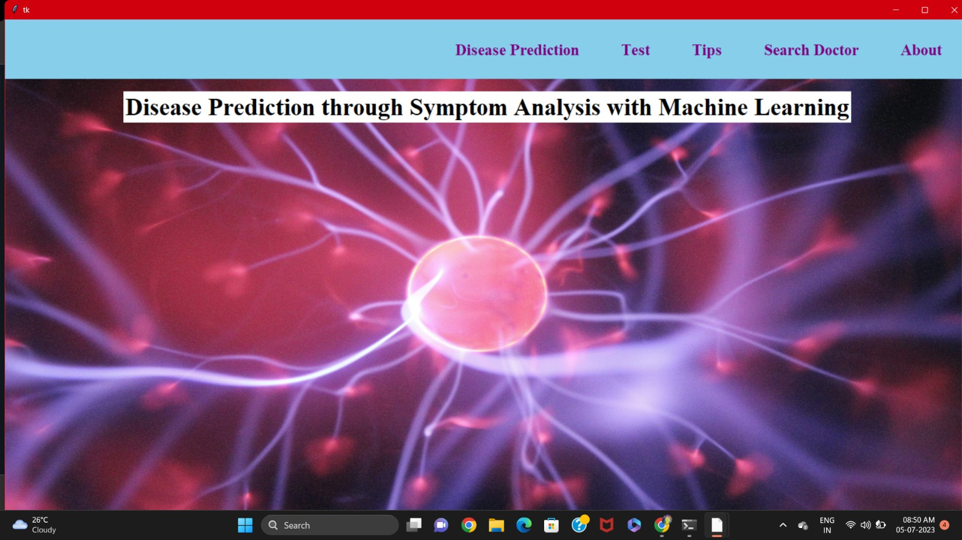
Front End

Slide 11
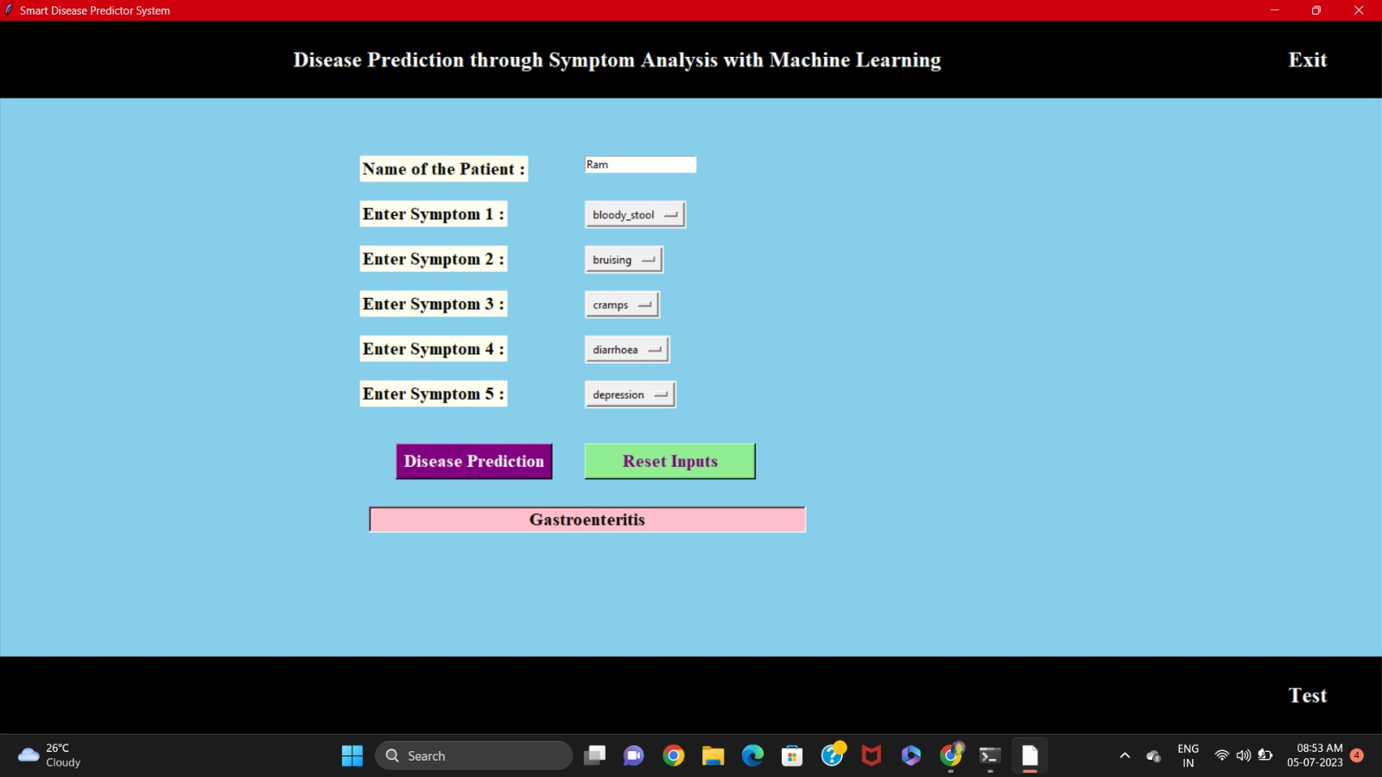
Disease Prediction UI

Slide 12
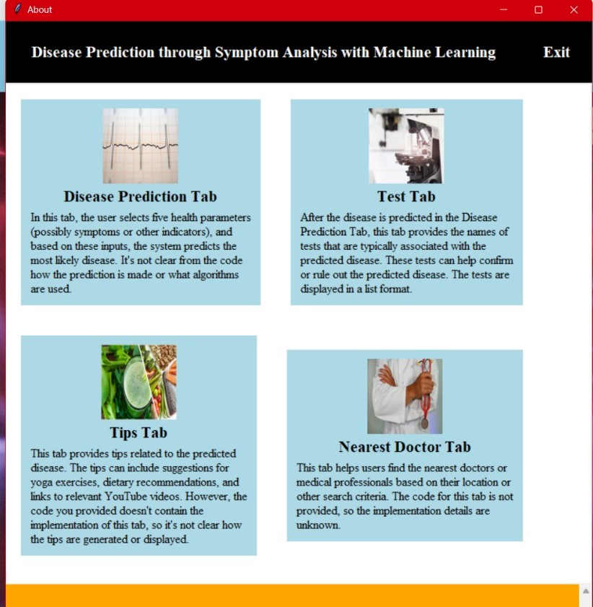
Features

Slide 13
Future scope
We will make Android application on this disease prediction in which we will add some more diseases.
Also recommend some near-by hospital’s according to user’s location and disease. The future scope of the paper is the prediction of all diseases by using advanced techniques and algorithms in less time complexity.

Slide 14
CONCLUSION
Various diseases detection model has been developed using ML classification modelling techniques. This project predicts whether the paitent has disease or not by extracting the patient medical history from a dataset such as chest pain, blood pressure, etc.
The algorithms used in building the given model are Logistic regression, Random Forest Classifier ,KNN,etc.
The accuracy of our Breast Cancer Model prediction is 93.5%.
The accuracy of our Heart Disease Prediction Model is 90%.
The accuracy of Kidney Disease prediction Model is 100%.
The accuracy of Diabetes Prediction Model is 80%.

Slide 15
Thank You

